Slide 1

“ Hello World ” our world for your social interactions

Slide 2
Application Backend Architecture →→→→→
1

Slide 3
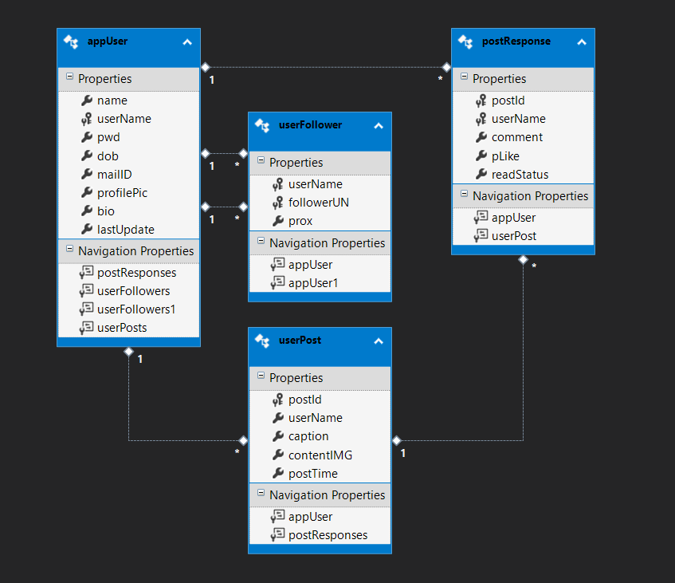

Slide 4
Entity One -> App User
Every user who sign‘s up will be uniquely identified with User ID
Password is hashed and stored in database for security purpose
App restricted for users above age 18
App users can sign up login looks at other users profile and their posts

Slide 5
Entity two -> App followers
A user can follow another user so that their posts automatically come up in their feed as soon as they post it

Slide 6
Entity three -> User Post
App Users can share posts
Post ID is used to track individual posts
A post usually has an image and a line of caption along with it.
Users can view their followers post over feed and can also view other persons profile
.

Slide 7
Entity Four ->Post response
Every user can like another users posts
These likes are stored in the database

Slide 8
Angular Program Flow →→→→→
1

Slide 9
Index.html
Main.ts
Appmodule.ts
Sign-up
Appcomponent.html
Appcomponent.ts
Search Bar
Service
Home
Login
Feed
Edit Profile
tracker
My Account
Profile View
API-routes
Add photo

Slide 10
API Controllers →→→→→
1

Slide 11
API User
Login
Appmodule.ts
Sign-up
Appcomponent.html
Appcomponent.ts
Get
Service
Home
Feed
Edit Profile
tracker
My Account
Profile View
API-routes
Add photo

Slide 12
Big concept
Bring the attention of your audience over a key concept using icons or illustrations

Slide 13
You can also split your content
White
Is the color of milk and fresh snow, the color produced by the combination of all the colors of the visible spectrum.
Black
Is the color of ebony and of outer space. It has been the symbolic color of elegance, solemnity and authority.

Slide 14
In two or three columns
Yellow
Is the color of gold, butter and ripe lemons. In the spectrum of visible light, yellow is found between green and orange.
Blue
Is the colour of the clear sky and the deep sea. It is located between violet and green on the optical spectrum.
Red
Is the color of blood, and because of this it has historically been associated with sacrifice, danger and courage.

Slide 15

A picture is worth a thousand words
A complex idea can be conveyed with just a single still image, namely making it possible to absorb large amounts of data quickly.

